Slide 1
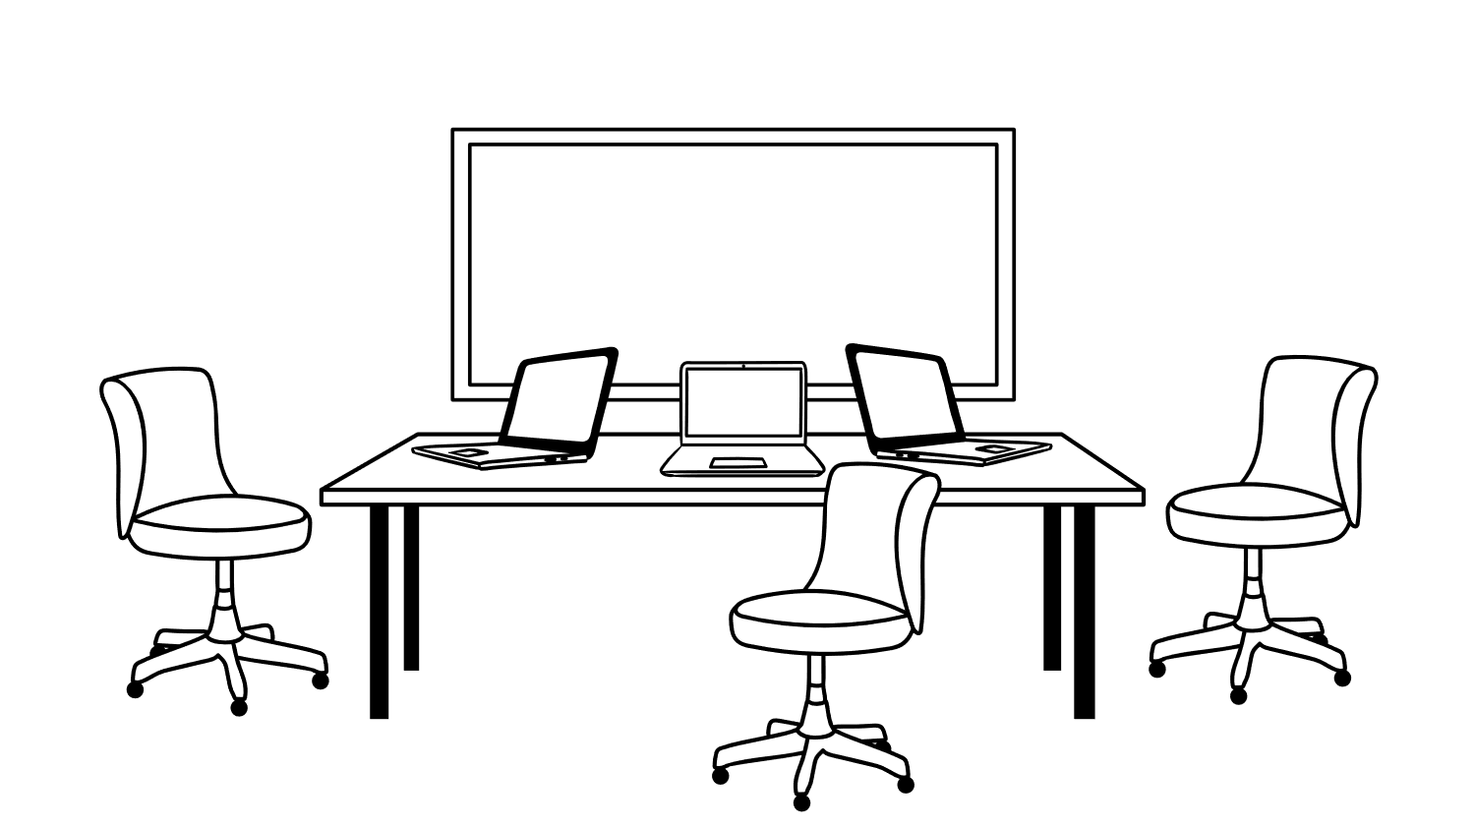
20 aprilie 2022 ora 16 MsTeams
The cyber effect in manierele
de azi
https://teams.microsoft.com/l/meetup-join/19%3aV76r2mqfIvPNMAMxttJha_f2bRaEa-SjO0Z-EKwSEFM1%40thread.tacv2/1649757004756?context=%7b%22Tid%22%3a%22a6eb79fa-c4a9-4cce-818d-b85274d15305%22%2c%22Oid%22%3a%227240a985-5ae0-49d7-9bed-739f9442b637%22%7d
Prezinta:
Dr.ec.Simona Sabo-martis
Consultant conslier de cariera AC

